Slide 1
GAME
DESIGN
101

Slide 2
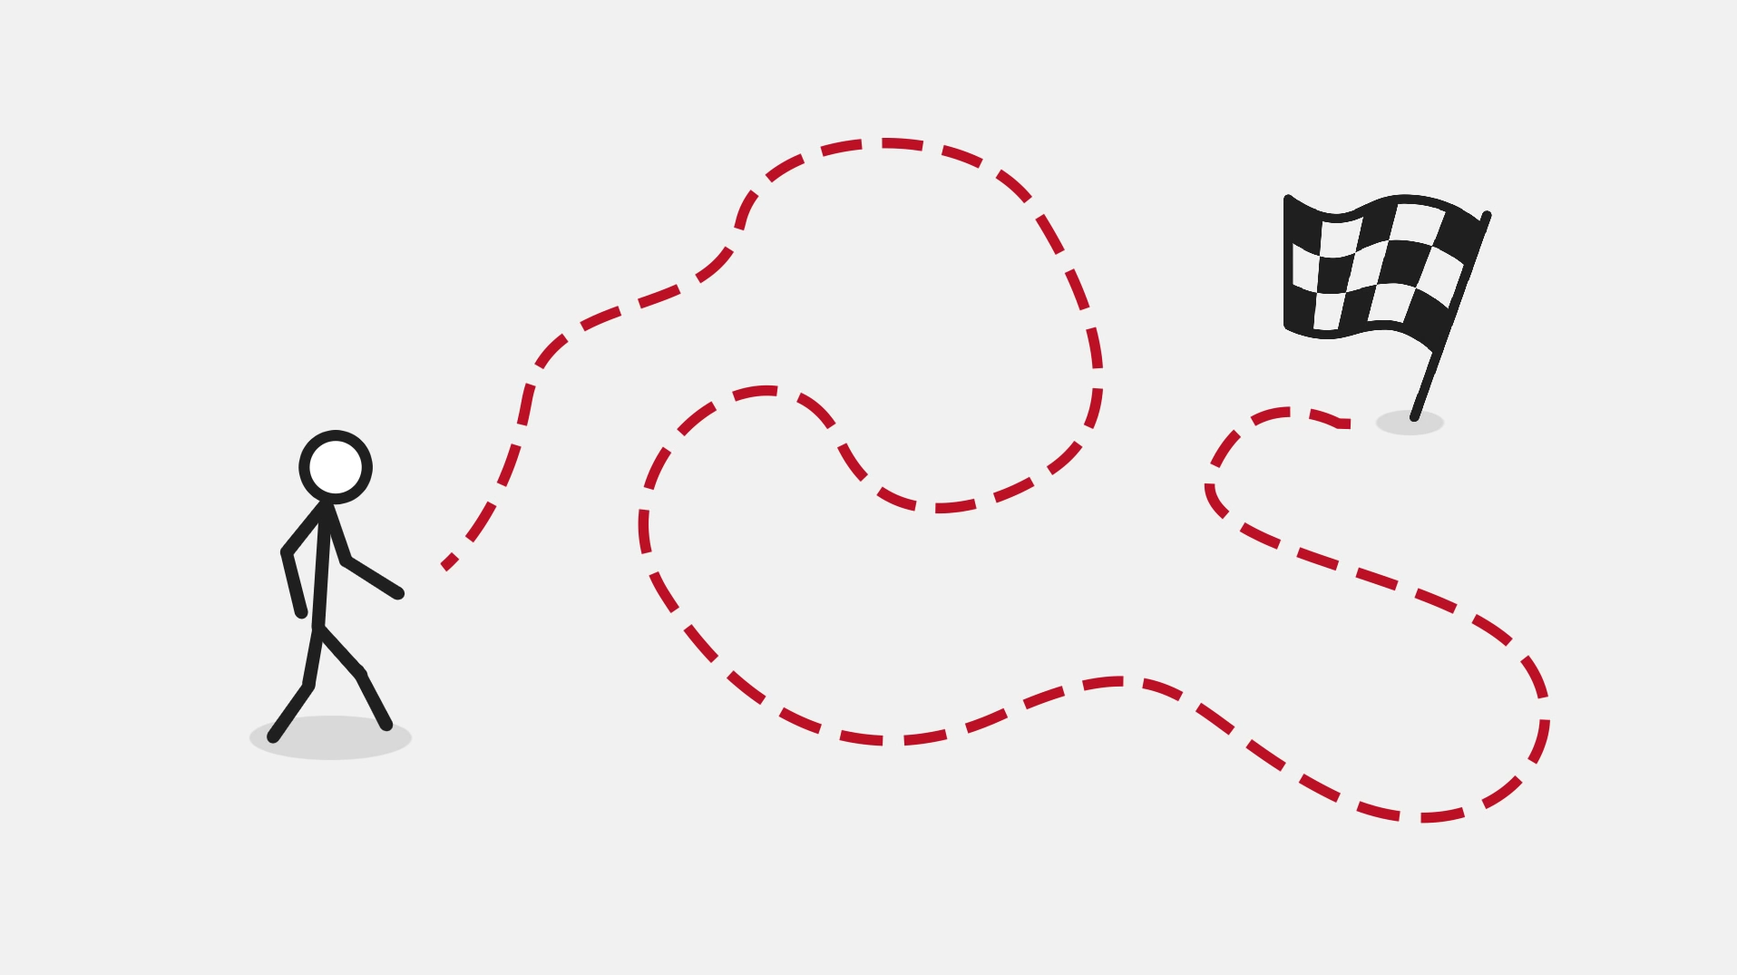
Objective
A goal the player has to achieve
Notes:
A goal that player has to achieve
Think about getting the player from start to the goal.
How would the player enjoy the journey as well.

Slide 3
RULES
PLAYER
GUIDELINES
Notes:
Rules that work for one game will not work for another for example a game of chess and an online fps shooter
Everything must fit player’s intended experience.

Slide 4
DESIGN FOUNDATION
PLAYER
COMMUNICATION
APPEAL
Notes:
Three pillar pretty obvious but how would they work together is crucial

Slide 5

PLAYER
Notes:
Three pillar pretty obvious but how would they work together is crucial
What is the player’s role?
How does the player interact with game
Always have the purpose and it is important that player drives the game forward not the other way around
Otherwise it is just like a movie simply completing tasks for the sake of it.

Slide 6
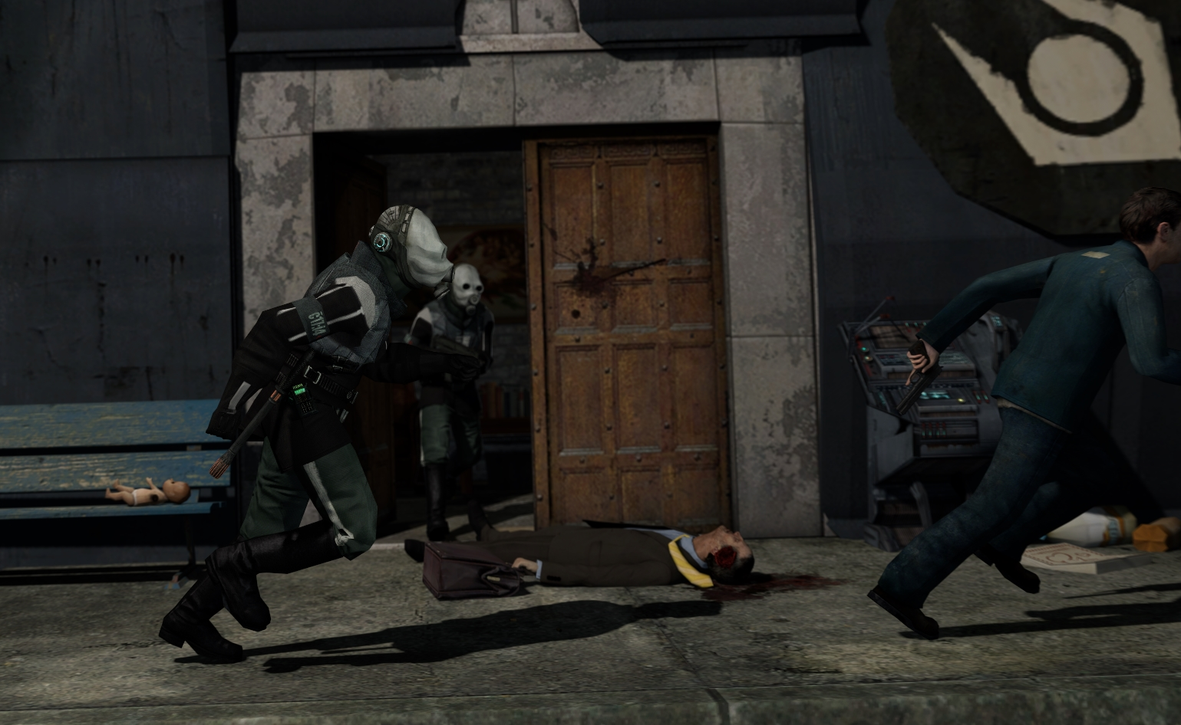
COMMUNICATION
Notes:
Communicating the purpose to the player without any idea of the goal and how to achieve it without this the player will feel powerless and bored.
Use the game environment or leave visual clues that communicate the objective of current situation
Example: Half Life 2, showing an oppressed world from the very start and making player feel part of that world.
Eventually making him want to change it.

Slide 7
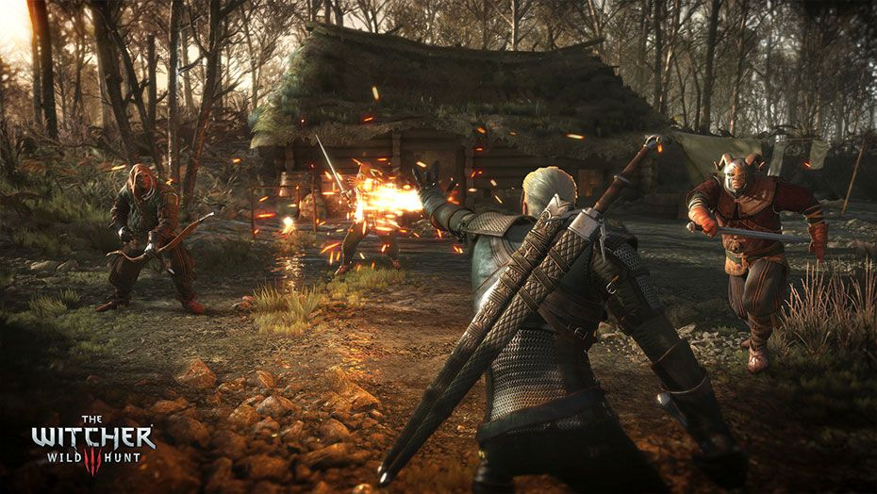
APPEAL
Notes:
The main pillar because otherwise why would the player stick to the game?
Hardest thing to consistently achieve because it is solely based on a feeling, being drawn to the game and of wanting to player more
Varies on game and player for some it would action paced realism for others it could stunning graphics and heart throbbing sound design or a story or a puzzle
Start with a prototype to test out the appeal of an idea in a simplified version.

Slide 8
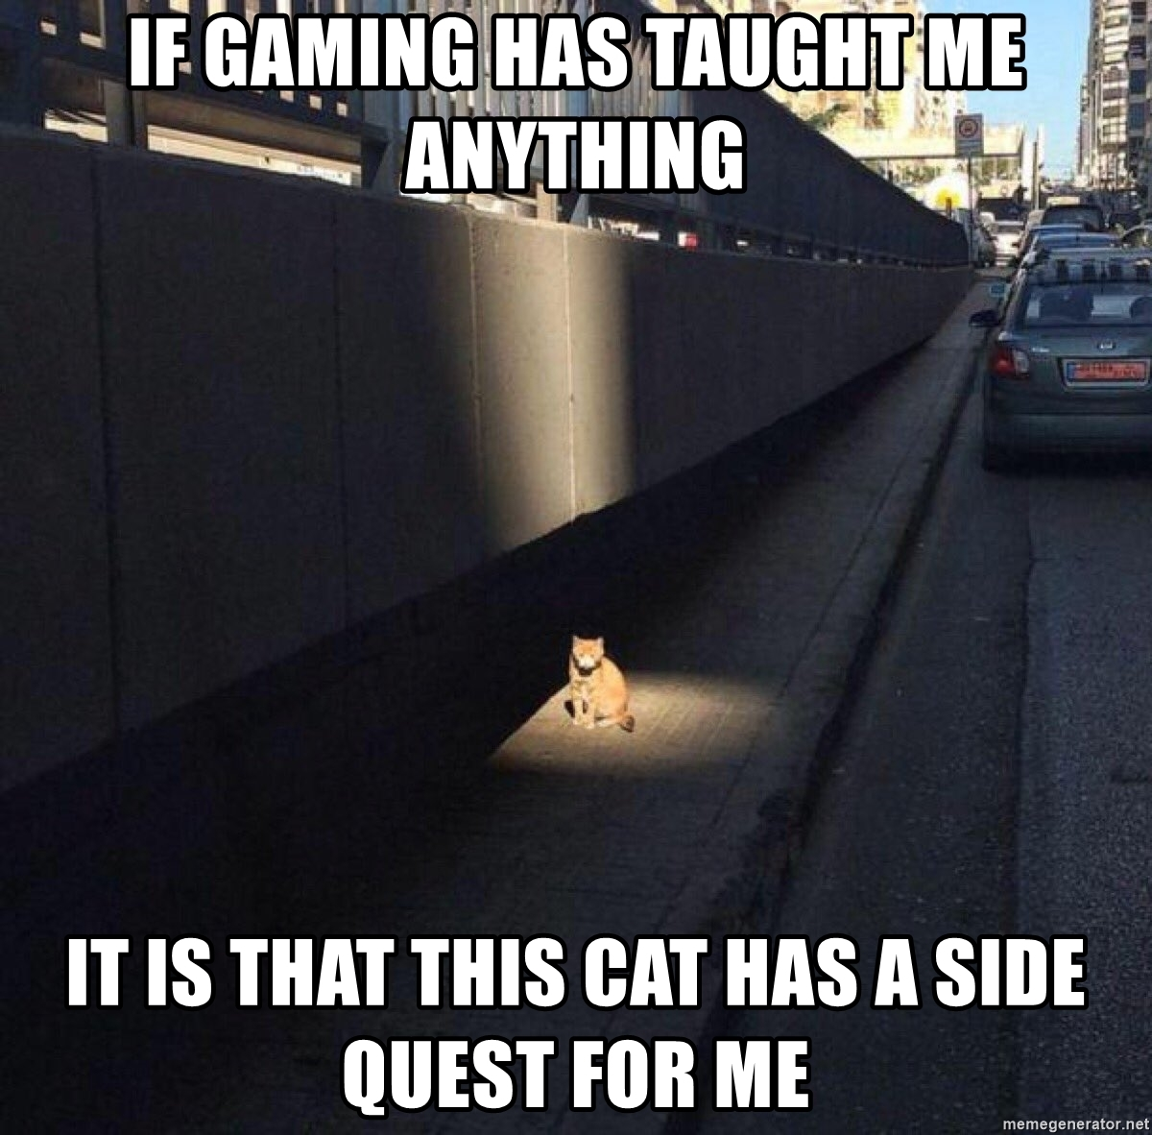
FOCUS
Notes:
Clarify what the player should focus on
This is not a must have thing in your game and you want to use this carefully in order to avoid static rules
Non linear game leave the player with alternate choices like a side quest that does not directly affect main storyline

Slide 9

ANTICIPATION
Notes:
If use correctly then it will prepare the player for what’s coming.
E.g. A charge up attack or the nuclear explosion in Far Cry 5
Blast, Shake, Sound, Explosion particle the whole sequence with Joseph talking is a one huge build up to the explosion

Slide 10
LOGICAL BEHAVIOUR
Living upto the player’s subconscious expectations
Right sounds
Rules of physics
Notes:
Rules should be consistent
RULES ARE RULES! Stick to established rules
But games can cheat as long as the player does not notice
E.g a racing game AI, games alters AI to give the player some advantage

Slide 11
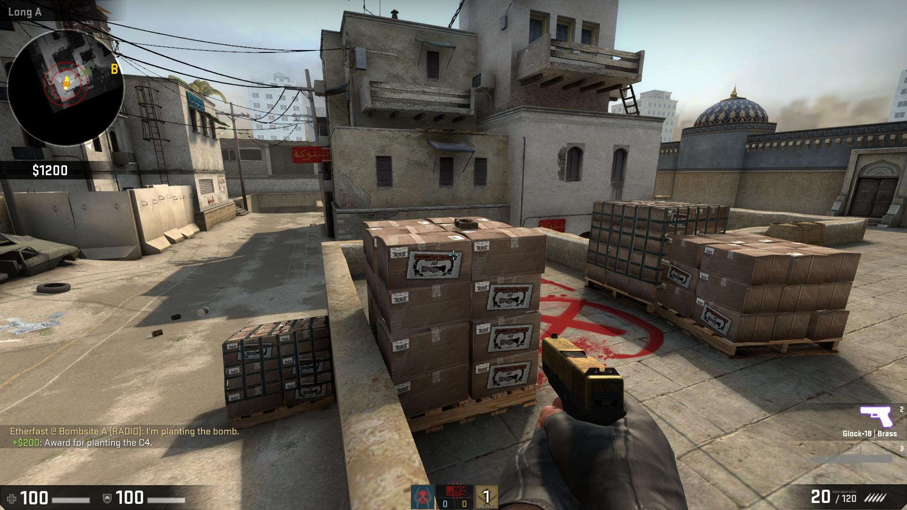
DYNAMICS
Notes:
Dynamic is lost if only one change occurs at a time. This is what makes competitive shooters compelling due to their highly dynamic worlds.
E.g. We do use same weapons and we play same maps but to plant the bomb many things should happen at the same time like someone throws a smoke grenade for the cover, another might sneak around to flank enemy team while others clear out the bomb site and one player should plant the bomb

Slide 12

SPACING
Notes:
Admire everything in the game environment from realistic graphics to claustrophobic feel in dense worlds e.g. Mountains vs Ghettos in GTA V
Effect gameplay because you have limited space on the map and the screen.
Give space to AI or other players so they can move around easily.

Slide 13
REMEMBER!
THESE WERE ONLY GUIDELINES!
Notes:
Guidelines help steer creativity in right direction. Should be enforced in a sensible manner.

Slide 14
Questions?

